Slide 1
General Assembly - DAT-19 Predicting NaNoWriMo Winners
Nicole Fronda

Slide 2
What is NaNoWriMo?
“On November 1, participants begin working towards the goal of writing a 50,000-word novel by 11:59 PM on November 30.
Valuing enthusiasm, determination, and a deadline, NaNoWriMo is for anyone who has ever thought about writing a novel.”
- http://nanowrimo.org/about
Notes:
50,000 words – about 1600 words per day
NaNoWriMo is also the name of the non-profit organization that runs the contest, and they also focus on promoting writing fluency and creative education in classrooms around the world and providing free resources to libraries
Over 300,000 participants
600 different regions
800 volunteers called Municipal Liaisons

Slide 3
Motivation: Tracking my Writing Progress
Notes:
Wanted to create my own word count tracker similar to that on the NaNoWriMo website
Created an R shiny app

Slide 4
Motivation: Tracking my Writing Progress
Goal: Predict if a writer or novel will win the next contest
Notes:
Wanted to create my own word count tracker similar to that on the NaNoWriMo website
Created an R shiny app
Visualizing progress can me very motivating

Slide 5
Writer Data
Past NaNoWriMos |  | Ongoing NaNoWriMo
Numerical | Binary | Numerical | Binary
Member Length | Municipal Liaison | First Week Word Count | Donor
Lifetime Word Count | Sponsorship | First Week Num Submissions
Number of Novels |  | Second Week Word Count
Count Wins |  | Second Week Num Submissions
Count Donations
Average Submission
Daily Average
Num Consecutive Years Participated
Num Consecutive Winning Years
Novel Data
Genre
Num Words in Synopsis/Excerpt
Num Unique Words in Synopsis/Excerpt
Num Sentences in Synopsis/Excerpt
Num Paragraph Synopsis/Excerpt
Reading Score of Synopsis/Excerpt

Slide 6
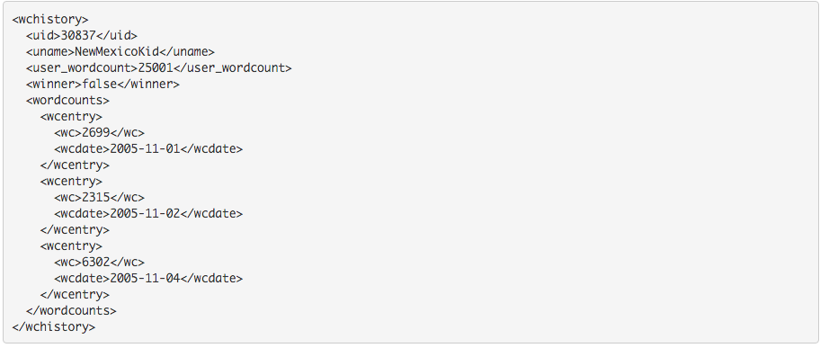
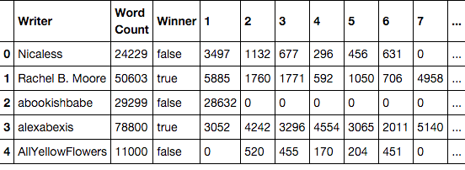
Getting the Data
Stats from Most Recent Contest – Word Count API
Notes:
get from this url and XML table of the users word count entries
Wrote a script to go through a list of 500 writers, get whether or not they are a winner, total word count, breakdown by day of the contest

Slide 7
Getting the Data
Web pages – Kimono Labs
Notes:
Profile data and past novel stats data not accessible by the Word Count API
Used Kimono labs to get:
Years participated (purple if they won, blue if otherwise)
Halo if they donated
Kimono Labs shut down their service as of today 2/29

Slide 8
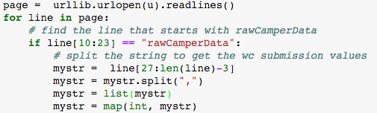
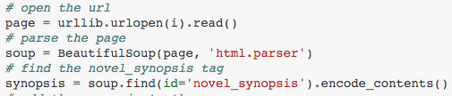
Getting the Data
Web pages – Beautiful Soup
Notes:
Wanted to get novel synopsis, and excerpt
Couldn’t use kimono labs to extract the text data for synopses and excerpt (crashed when I tried)
So parsed the web page using Beautiful Soup (simple, just a few lines)
Also wanted daily breakdown of word count submission for past novels
Graph is javascript, couldn’t use kimono labs either
Parsed the raw html doc for single javascript variable

Slide 9
Exploring the Data
501 Writers
219 won last contest
282 lost last contest
Writers with Sponsors
2x likely to Win
Municipal Liaisons
6x likely to Win
Notes:
Num Wins vs Num Participated ->
increase in number of years participated -> fewer red dots
higher the number of years someone has participated more likely they are to win
makes sense -> more seasoned writers will be more successful
Were able to commit to writing and make a submission every day of the first week of the contest, more likely to win

Slide 10
Writer Data
Past NaNoWriMos |  | Ongoing NaNoWriMo
Numerical | Binary | Numerical | Binary
Member Length | Municipal Liaison | First Week Word Count | Donor
Lifetime Word Count | Sponsorship | First Week Num Submissions
Number of Novels |  | Second Week Word Count
Count Wins |  | Second Week Num Submissions
Count Donations
Average Submission
Daily Average
Num Consecutive Years Participated
Num Consecutive Winning Years
Novel Data
Genre
Num Words in Synopsis/Excerpt
Num Unique Words in Synopsis/Excerpt
Num Sentences in Synopsis/Excerpt
Num Paragraph Synopsis/Excerpt
Reading Score of Synopsis/Excerpt
2123 Novels
1333 winners
790 non-winners

Slide 11
Predicting Winning Novels from Text Features
Could not create an effective model with text features
Logistic Regression – 63%
K Neighbors – 63%
Naïve Bayes – 59%
Support Vector Machine – 63%
Decision Tree – 63%
Random Forest – 63%
Notes:
Basically just guessing…
Maybe I’ll try more advanced rebalancing of the novel data set
Maybe some more clever feature engineering of the text features
Maybe text of the novel synopsis/excerpt has nothing to do with winning at all

Slide 12
Writer Data
Past NaNoWriMos |  | Ongoing NaNoWriMo
Numerical | Binary | Numerical | Binary
Member Length | Municipal Liaison | First Week Word Count | Donor
Lifetime Word Count | Sponsorship | First Week Num Submissions
Number of Novels |  | Second Week Word Count
Count Wins |  | Second Week Num Submissions
Count Donations
Average Submission
Daily Average
Num Consecutive Years Participated
Num Consecutive Winning Years

Slide 13
Writer Data
Past NaNoWriMos |  | Ongoing NaNoWriMo
Numerical | Binary | Numerical | Binary
Member Length | Municipal Liaison | First Week Word Count | Donor
Lifetime Word Count | Sponsorship | First Week Num Submissions
Number of Novels |  | Second Week Word Count
Count Wins |  | Second Week Num Submissions
Count Donations
Average Submission
Daily Average
Num Consecutive Years Participated
Num Consecutive Winning Years

Slide 14
Logistic Regression – Predicting Winning Writers
 | Actual 0 | Actual 1
Predicted 0 | 46 | 7
Predicted 1 | 22 | 34
 | Precision | Recall | F1-Score | Support
0 | 0.69 | 0.87 | 0.77 | 55
1 | 0.77 | 0.52 | 0.62 | 46
avg/total | 0.73 | 0.71 | 0.70 | 101
Other Models:
Naïve Bayes – 67%
Support Vector Machine – 72%
Decision Tree – 65%
Random Forest – 74%

Slide 15
Writer Data
Past NaNoWriMos |  | Ongoing NaNoWriMo
Numerical | Binary | Numerical | Binary
Member Length | Municipal Liaison | First Week Word Count | Donor
Lifetime Word Count | Sponsorship | First Week Num Submissions
Number of Novels |  | Second Week Word Count
Count Wins |  | Second Week Num Submissions
Count Donations
Average Submission
Daily Average
Num Consecutive Years Participated
Num Consecutive Winning Years

Slide 16
Logistic Regression – Predicting Winning Writers Include Word Count from current contest
 | Actual 0 | Actual 1
Predicted 0 | 46 | 9
Predicted 1 | 8 | 38
 | Precision | Recall | F1-Score | Support
0 | 0.85 | 0.84 | 0.84 | 55
1 | 0.81 | 0.83 | 0.82 | 46
avg/total | 0.83 | 0.83 | 0.83 | 101
Train Data – 1st & 2nd PC
Test Data Predictions – 1st & 2nd PC
Test Data Actual Outcomes – 1st & 2nd PC

Slide 17
Logistic Regression – Predicting Winning Writers
Feature | Measured Importance
Second Week Word Count | 0.712847
LifetimeWordCount | 0.057194
Second Week Num Submissions | 0.045414
Expected Avg Submission | 0.039117
Consecutive Part | 0.036241
Data of progress in first few weeks helps improve predictions

Slide 18
Next Steps
Improving the model
Collect more data
Feature Engineering
Predicting Final Word Count
Discovering clusters of writers

Slide 19
Next Steps
Improving the model
Collect more data
Feature Engineering
Predicting Final Word Count
Discovering clusters of writers
Win the Next NaNoWriMo ☺

Slide 20
Questions?

Slide 21
Motivation: Tracking my Writing Progress
Notes:
The app also visualized writing progress of the whole NaNoWriMo site
Broken down by region
Forecasted a user’s progress
Even though forecast my not look too great, seeing a visual of one’s writing progress can be very motivating
What could also be motivating is knowing how well one can do on the upcoming NaNoWriMo contest, before the contest even starts

Slide 22
Exploring the Data
501 Writers
219 won last contest
282 lost last contest
Writers with Sponsors
2x likely to Win
Municipal Liaisons
6x likely to Win
Notes:
If Expected Daily Average => Expected Avg Submission, a writer is more likely to win.

Slide 23
Exploring the Data: Novels
2123 Novels
1333 winners
790 non-winners
A well written synopsis probably has nothing to do with winning or losing NaNoWriMo
Notes:
CUT or rethink graphs

